Slide 1
Progress report 20/09
Anh Tuan Cao

Slide 2
Overview
Backblaze Hard Drive Dataset (continue)
Bearing ring Dataset (continue)
Injection molding lego Dataset (continue)
Hyperparameter optimization in CL
Dynamic output expansion

Slide 3
Backblaze Hard drive dataset (Continue)
Predictive maintenance:
Aims to reduce expenses from 2 angles:
Minimizing time or asset spends in maintenance due to a failure detected too late.
Limit maintenance performed on a machine, performing it only when necessary.
Challenge :
Data availability: not many public dataset, data protection, etc..
Data quality: imbalance, missing data
Realistic Benchmark: there should be a connection between solution and problem it aims to tackle.
Continual learning: in need of decent setup to reflect real world scenario

Slide 4
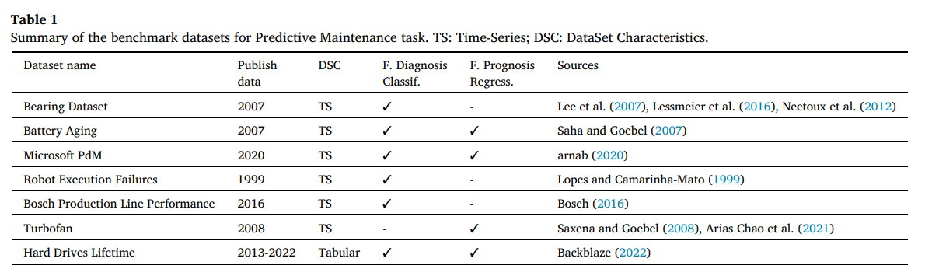
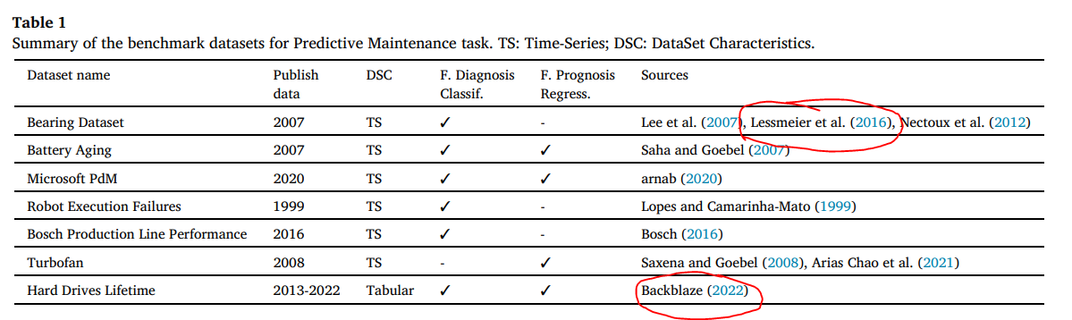
Backblaze Hard drive dataset (Continue)
Predictive maintenance:

Slide 5
Backblaze Hard drive dataset (Continue)
Predictive maintenance:
One of the best method to predict failure is to identify the different types of drift and how they affect the object. Drift has some characteristics :
The first is the graduality with which changes take place. These can be abrupt or gradual.
Another characteristic is whether they are permanent or transient.
Example:
Abrupt drift: A sudden increase in vibration amplitude or noise levels, often associated with cracks, spalling.
Gradual drift: Gradual increase in the number of bad sectors or a slow rise in read/write latency over time could indicate the disk is wearing out and approaching failure.
Permanent Drift: once a sector becomes bad and data is reallocated, the change is permanent, indicating physical damage that cannot be reversed.
Transient Drift: A temporary increase in temperature due to a high workload that normalizes once the workload decreases; this drift is not necessarily indicative of a permanent issue.
Understanding these characteristics will helps understanding the Dataset better (choosing suitable input for the model )

Slide 6
Backblaze Hard drive dataset (Continue)
Dataset review
The Backblaze data report the SMART values of hard drives at the end of each day.
A daily snapshot of a single disk is "one record or row of data"
All disk snapshots for a particular day are collected into a file consisting of rows for each active hard disk.
Thus, each day a file with the name in the format YYYYY-MM-DD.csv is formed.
the first line of each file contains the column names, the remaining lines are historical data of the drive status.
columns contain the following information:
date - file date in YYYY-mm-dd format;
serial number
the drive serial number assigned by the manufacturer;
model - the drive model number assigned by the manufacturer
capacity - the capacity of the drive in bytes
failure - contains «0» if the drive is OK. Contains a «1» if this is the last day the drive was operational before the failure.
SMART stats: consist of normalized and raw value from 1 to 254

Slide 7
Backblaze Hard drive dataset (Continue)
Why are there multiple SMART value that track same concept ?
SMART is not fully standardized across all manufacturers.
The ATA (Advanced Technology Attachment) standard defines some attributes, but manufacturers have room to define and implement vendor-specific attributes. This leads to different vendors using different numbers and methods for similar metrics, such as lifespan.
Even though two attributes (like SMART 169 and SMART 202) might track a similar concept, they may represent it in different ways depending on how the manufacturer expects users to interact with the data. For instance:
Western Digital (SMART 169): Uses a decreasing value from 100 to 0 to indicate how much of the lifespan remains. This might be intuitive for users who want to know how much life their drive still has.
Crucial (SMART 202): Uses an increasing value from 0 to 100 to indicate how much of the lifespan has been used. This can be useful for users or systems that track how much wear the drive has endured so far.
Different manufacturers may have different philosophies on how to track and report drive health. Some vendors prioritize remaining lifespan, while others may focus on how much of the drive’s lifespan has been used up.

Slide 8
Backblaze Hard drive dataset (Continue)
Raw Value vs Normalized Value
Raw Value: This is the actual, direct measurement of the attribute (such as the number of bad sectors or hours powered on).
Manufacturer-specific.
Can be difficult to interpret directly.
Not user-friendly, as it often requires interpretation.
Normalized Value: This is a scaled, user-friendly number designed to represent the health of that particular attribute.
Generally follows a 1-100 scale.
Provides a better, more intuitive sense of drive health.
Easier to interpret for non-technical users.

Slide 9
Backblaze Hard drive dataset (Continue)
Raw Value vs Normalized Value
Example: SMART - 1
1. Raw Value:
The raw value for Read Error Rate usually represents the actual number of low-level read errors that have occurred. However, this raw value is often more complex than a simple count, as it may include additional information like error-correction events, retries, or other factors.
Example: The raw value might be a large number (e.g., 123456789), and it’s typically not useful to directly interpret this number without knowing how the manufacturer calculates it. For some drives, this might represent the number of sectors that needed error correction during read operations.
2. Normalized Value:
The normalized value typically starts at 100 or 200 (depending on the manufacturer) and decreases over time as more read errors are detected.
A higher normalized value indicates that the drive is reading data reliably, whereas a lower value indicates deteriorating read performance.
Example: For a healthy drive, the normalized value might be 100 or higher. As the drive ages or if there are serious read problems, the value might drop. If the normalized value drops to something like 50, it could indicate that the drive is starting to have difficulty reading data consistently.
Other failure-related SMART-Stats are also documented.

Slide 10
Backblaze Hard drive dataset (Continue)
Drive failure detection
Proactive Drive Failure Prediction for Large Scale Storage Systems
Dataset: from Baidu Inc. 23.395 sample with same model.
Good drive: sample in a week are kept.
Bad drive: sample 20 days before failure are kept.
Also for some (but not all) failed drives, several particular attributes show significant downward trend over time. They are VALUEs of attributes #1, #5, #187, #195, #197 and RAW VALUEs of attributes #5 and #197. For every sample, we calculate the absolute differences between the current values of these attributes and their corresponding values six hours ago as features.
Input :
10 SMART attribute normalized values (1,3,5,7,9,187,189,194,195,197)
2 RAWs value (5, 197)
7 changes rate.
Models : 3 layers 19,30,1, epochs: 400, lr: 0.1, activation: sigmoid
Evaluation: Detection rate (True-positive), False Alarm Rate (False-positive)

Slide 11
Backblaze Hard drive dataset (Continue)
Drive failure detection
Predictive models of hard drive failures based on operational data
Dataset: Backblaze dataset:
Two SMART parameters, SMART 9, power-on hours, and SMART 194, temperature. In turned out that this filtering is negligible and does not noticeably impact the dataset with only 5 drives concerned.
Introduce a new hyperparameter: time window: after a drive fails, we relabel a posteriori the N previous samples from this particular drive as failures where N is the length of the time window in days. In other words, with our classification model we try to answer the question ”Is the hard drive going to fail in the next N days?”. This length will be optimized as a hyper parameter of the model to determine its optimal value if it exists.
Input: nine raw SMART parameters number 5, 12, 187, 188, 189, 190, 198, 199 and 200.
ML algorithm (Support Vector Machine , Random Forest, Gradient boosted tree)
Evaluation: Detection rate (positive), False Alarm Rate (False-positive)

Slide 12
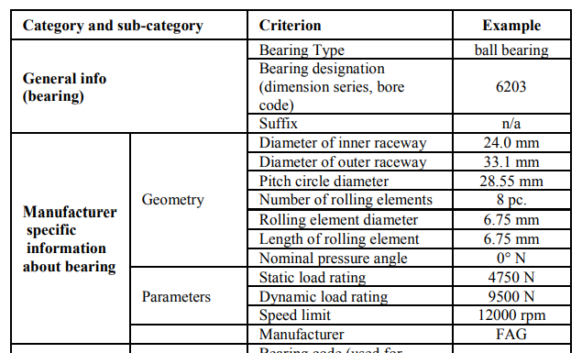
2. Bearing ring dataset (Continue)
Bearing Dataset – Uni Paderborn
One bearing ring model is used in this experiment

Slide 13
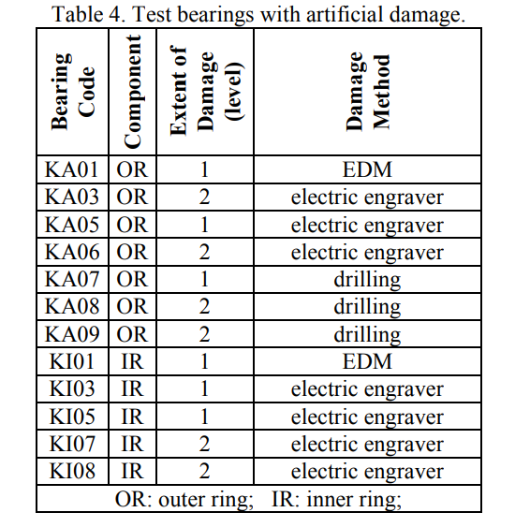
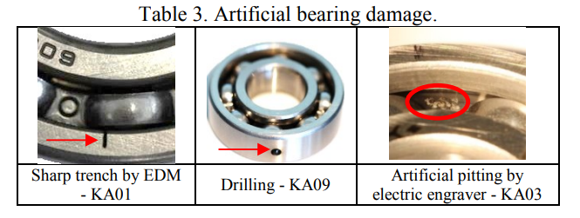
2. Bearing ring dataset (Continue)
Bearing Damage
Bearing Damage is generated either by artificial or real damages
Artificial damage:
electric discharge machining (trench of 0.25 mm length in rolling direction and depth of 1-2 mm),
drilling (diameter: 0.9 mm, 2 mm, 3 mm)
manual electric engraving (damage length from 1-4 mm).

Slide 14
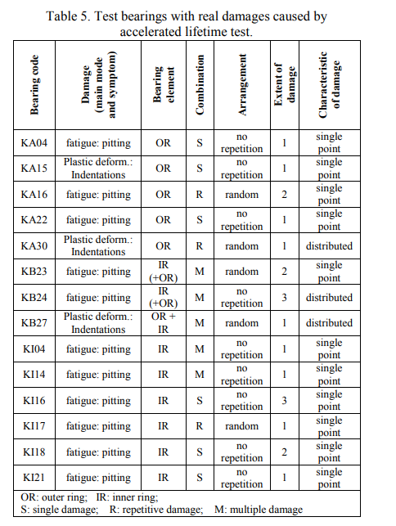
2. Bearing ring dataset (Continue)
Bearing Damage
Bearing Damage is generated either by artificial or real damages
Real damage is generated by accelerated lifetime test.
Estimate the long-term performance, reliability, and lifespan of a product or component within a shorter time frame than would be possible under normal usage conditions.
This is achieved by subjecting the product to intensified stress factors, such as increased load, temperature, pressure, humidity, vibration, or electrical stress,

Slide 15
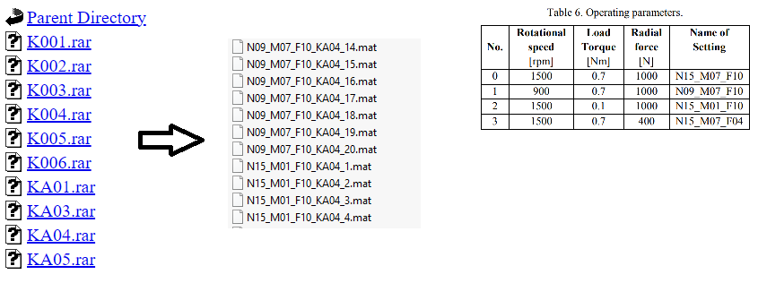
2. Bearing ring dataset (Continue)
Bearing data
The dataset is divided into multiple files with experiment on a bearing ring with bearing damage code.
Each scenario is run with different settings (operating parameter) and each setting is recorded 20 times.
Each measurement is recorded into a mat file

Slide 16
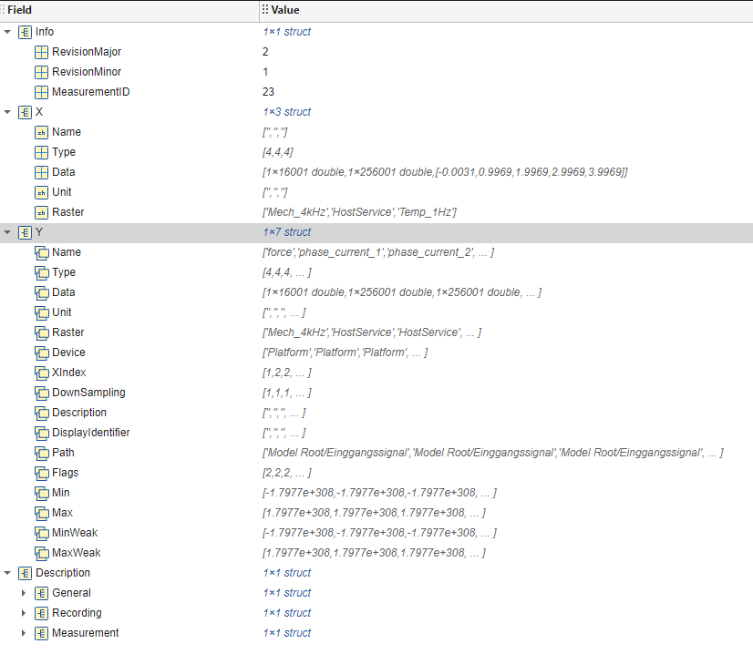
2. Bearing ring dataset (Continue)
Bearing data
Each mat file contain information of a measurement.
For example: IDs, timestamp, duration, personal, etc..

Slide 17
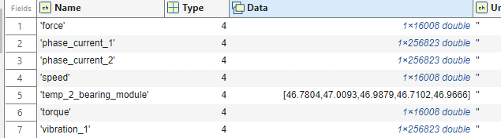
2. Bearing ring dataset (Continue)
Bearing data
We are only interested in Y field
Measuring time is 4s
It contain:
Operating parameter with sampling rate of 4 KHz.
Two motor current signal with sampling rate of 64 KHz.
Vibration Signals with sampling rate of 64 KHz.

Slide 18
2. Bearing ring dataset (Continue)
Motor Current Signal and Vibration Signal
Motor Current Signal: Motor current signals refer to the electrical signals derived from the current flowing through the motor. These signals contain valuable information about the operating conditions of the motor and bearings.
Advantages:
Non-invasive and can be monitored remotely without requiring direct access to the bearing or motor.
Cost-effective compared to vibration sensors as it uses existing electrical signals.
Limitations:
Less sensitive than vibration analysis for early-stage fault detection.
Requires advanced signal processing techniques to accurately extract fault features due to noise and other electrical disturbances.
Vibration Signal: Vibration signals are physical signals captured using accelerometers or other vibration sensors placed directly on the bearing housing or nearby structures. These signals measure the mechanical vibrations caused by the bearings.
Advantages:
High sensitivity to bearing defects, especially in the early stages of damage.
Provides detailed information about the nature and severity of the fault.
Can detect a wide range of faults, including misalignment, imbalance, and looseness, in addition to bearing issues.
Limitations:
Requires direct sensor placement, which may not always be feasible.
Sensors can be costly, and installation requires careful positioning for accurate measurements.
Vibration data can be complex to interpret, requiring specialized knowledge and signal processing.

Slide 19
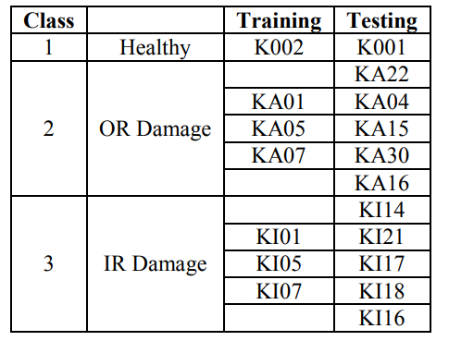
2. Bearing ring dataset (Continue)
Damage classification
Data preprocessing: extract frequency feature with (FFT and PSD) -> Feature extraction: 23 distinct Feature
Feature: 9 out of 23 features are selected from each of the two MCS per sample and 15 features from the vibration signals.
Then separate data into test and training data

Slide 20
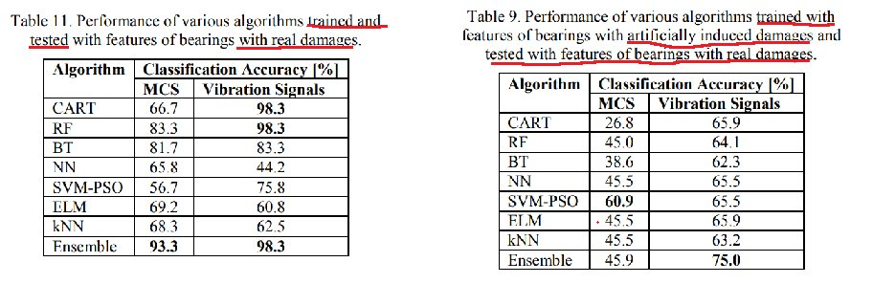
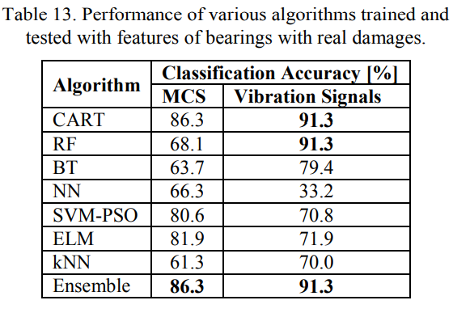
2. Bearing ring dataset (Continue)
Damage classification
Different machine learning methods are used on different scenario (single damage only vs with multiple damage)

Slide 21
3. Injection molding Logo (continue)
Paper survey:
This problem belong to quality prediction.
In most industrial practices, the process variables are determined by trial-and error method or computer added engineering (CAE) software. However, these conventional methods have limitation such as high time and cost consumption and sensitivity to the technical skills of an engineer.
Injection molding is known to affect the mass, length, warpage, and shrinkage of the final product
Mass : refers to the weight of the molded part or product.
Length : refers to the dimensional measurement of the molded part, particularly its longest axis.
Warpage : is the distortion or deformation of a molded part from its intended shape, often resulting in bending, twisting, or uneven surfaces.
Shrinkage is the reduction in size of the molded part as it cools and solidifies. It is a natural phenomenon caused by the contraction of the polymer material when transitioning from a molten state to a solid state.
And there are many more parameter to define quality of final products.

Slide 22
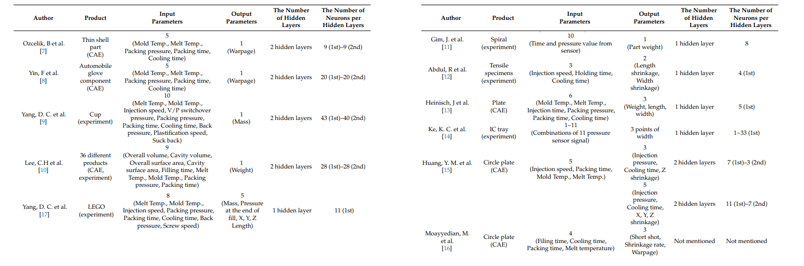
3. Injection molding Logo (continue)
Paper survey:
Here are some paper related to injection molding process for input / output reference

Slide 23
3. Injection molding Logo (continue)
Injection Molding Lego Data
Manufacturing Process: Injection molding is a process used to produce plastic products in a single production step. It involves:
Plasticization: The plastic material is first heated and melted.
Injection: The melted plastic is then injected into a mold cavity, where it takes the shape of the desired product.
Cooling: The plastic cools down within the mold, solidifying into the final product shape.
Study Objective:
Predict quality metrics of parts : maximum deformation of parts under load
Data:
There are 16 classes of plastic blocks, created by combining different configurations of studs and rows:
Studs per row: 1, 3, 6, or 8
Rows: 1 or 2
There are 77 examples for each part by varying the input parameters
Each class of block has distinct characteristics or statistics.

Slide 24
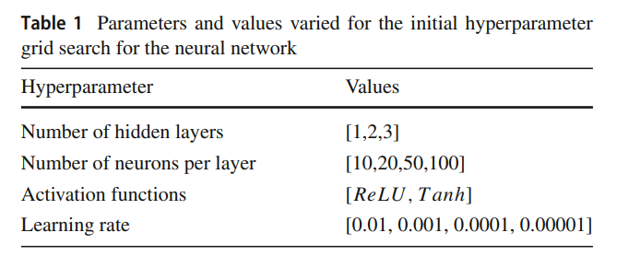
3. Injection molding Logo (continue)
Paper method
Continual learning method: MAS (memory aware synapses) is also parameter regulation technique.
Hyperparameter tunning.
Input / output.

Slide 25
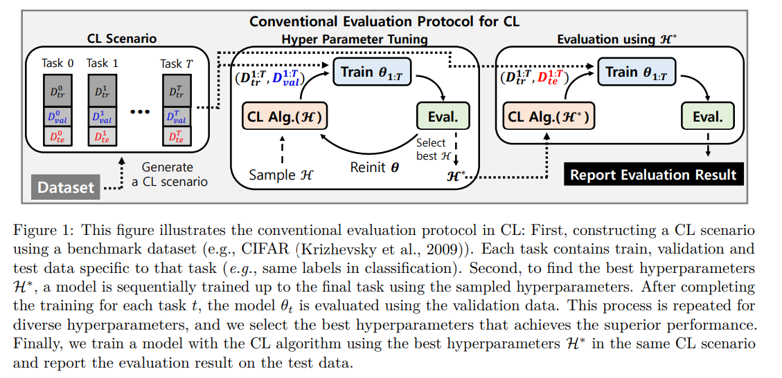
3. Hyperparameters Optimization in CL (continue)
Hyperparameter in CL
Conventional method:

Slide 26
3. Hyperparameters Optimization in CL (continue)
Hyperparameter in CL
Conventional method : Disadvantages
this protocol does not sufficiently assess how well an algorithm can generalize to new, unseen scenarios (i.e., situations that the algorithm hasn't encountered during training).
Instead of evaluating the algorithm’s ability to adapt and perform in different environments or tasks (which is crucial for CL), the protocol focuses on a very specific scenario. This can cause overfitting of the evaluation to that particular task or dataset.
The result is that the algorithm may appear to have better CL capabilities than it actually does because it performs well in the specific scenario defined by the evaluation protocol. This leads to an overestimation of the CL capacity.

Slide 27
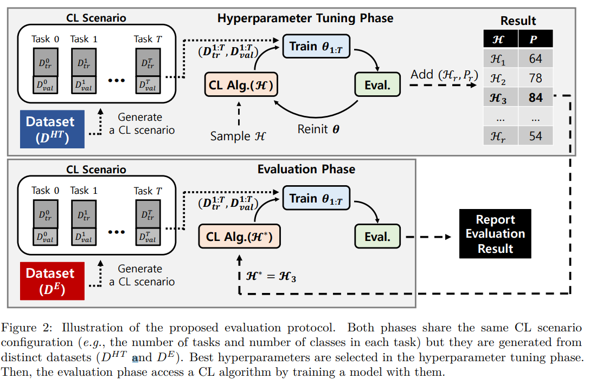
3. Hyperparameters Optimization in CL (continue)
Proposed method:

Slide 28
3. Hyperparameters Optimization in CL (continue)
Proposed method:

